Slide 1
Lecture 7:
GAME PLAYING

Slide 2
Relation of Games to Search
Search – no adversary
  Solution is (heuristic) method for finding goal
  Heuristics and CSP techniques can find optimal solution
  Evaluation function: estimate of cost from start to goal
  Examples: path planning, scheduling activities
Games – adversary
  Solution is strategy (strategy specifies move for every possible opponent reply).
  Time limits force an approximate solution
  Evaluation function: evaluate “goodness” of game position
  Examples: chess, checkers, backgammon

Slide 3
Game setup
Two players: MAX and MIN
MAX moves first and they take turns until the game is
over.
Winner gets award, looser gets penalty.

Slide 4
Game as Search Problem
Initial State: board position and player to move
Successor Function: returns a list of legal (move, state) pairs
Terminal Test: determines when the game is over
Utility function: Gives a numeric value for the terminal state
Notes:
chess utility = +1, 0, -1
backgammon utility = -192 to +192

Slide 5
Game Trees
Game trees are used to represent two-player games.
Alternate moves in the game are represented by alternate levels in the tree.
Nodes in the tree represent positions.
Edges between nodes represent moves.
Leaf nodes represent won, lost or drawn positions.

Slide 6
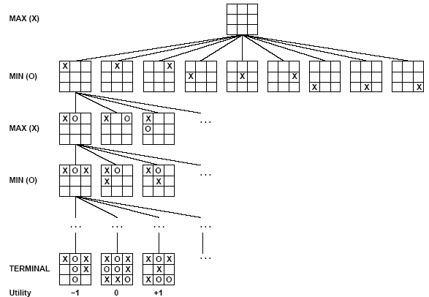
Game Trees
This is an example of a partial game tree for the game tic-tac-toe.
Even for this simple game, the game tree is very large.

Slide 7
Assumptions
In talking about game playing systems, we make a number of assumptions:
  The opponent is rational – will play to win.
  The game is zero-sum – if one player wins, the other loses.
  Usually, the two players have complete knowledge of the game. For games such as poker, this is clearly not true.
Notes:
deterministic, turn-taking, two-player, zero-sum games or perfect information

Slide 8
Minimax
Minimax is a method used to evaluate game trees.
A static evaluator (Situation analyzer) is applied to leaf nodes, and values are passed back up the tree to determine the best score the computer can obtain against a rational opponent.

Slide 9
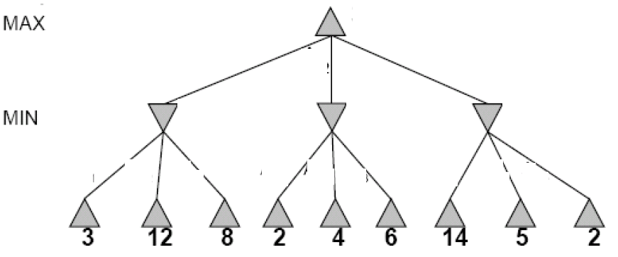
Two-Ply Game Tree

Slide 10
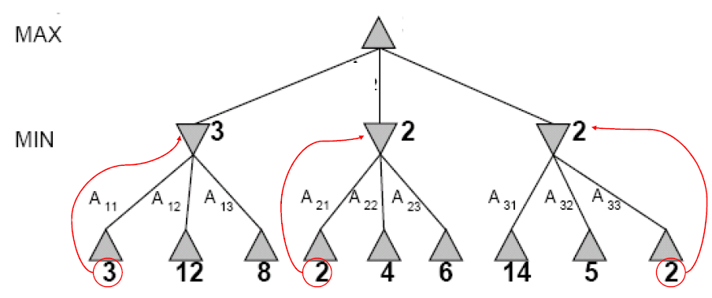
Two-Ply Game Tree

Slide 11
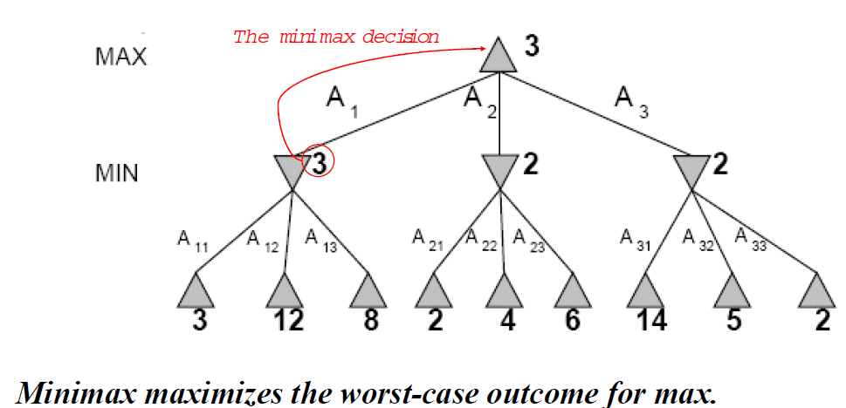
Two-Ply Game Tree

Slide 12
Minimax –Example
Max
3
6
The computer can obtain 6 by choosing the right hand edge from the first node.
6
Min
5
3
Max
1
3
6
0
7
5
5
2
1
3
6
2
0
7

Slide 13
Minimax Function
MINIMAX-VALUE(n) =
  UTILITY(n) if n is a terminal state
  max_{s} _{∈ Successors(n)} MINIMAX-VALUE(s) if n is a MAX node
  min_{s} _{∈ Successors(n)} MINIMAX-VALUE(s) if n is a MIN node
Notes:
minimax performs complete depth-first search of tree O(b^m) where max depth of tree = m and b legal moves at each point
for real games this time cost is totally impractical

Slide 14
Searching Game Trees
Exhaustively searching a game tree is not usually a good idea.
Even for a game as simple as tic-tac-toe there are over 350,000 nodes in the complete game tree.
An additional problem is that the computer only gets to choose every other path through the tree – the opponent chooses the others.

Slide 15
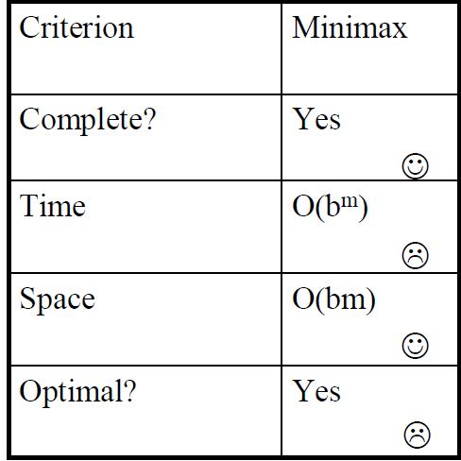
Properties of Minimax

Slide 16
Problem of minimax search
Number of games states is exponential to the
number of moves.
  Solution: Do not examine every node
  ==> Alpha-beta pruning
    Alpha = value of best choice found so far at any choice
    point along the MAX path
    Beta = value of best choice found so far at any choice point along the MIN path

Slide 17
Alpha-beta Pruning
A method that can often cut off a half the game tree.
Based on the idea that if a move is clearly bad, there is no need to follow the consequences of it.
alpha – highest value we have found so far
beta – lowest value we have found so far

Slide 18
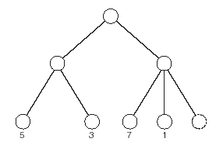
Alpha-beta Pruning – Example.
max
3
In this tree, having examined the nodes with values 7 and 1 there is no need to examine the final node.
min
Notes:
optimal time – O(b^(m/2)) instead of O(b^m)
branching factor goes from b to sqrt(b)
order of nodes matters
random order: O(b^(3m/4))
chess: order (capture first, then threats, then forward moves, then backward moves) gets within factor of 2 of best case
adding dynamic ordering – try moves that were best last time brings close to theoretical limit

Slide 19
Alpha Beta Pruning
=3
>=3
A
Maximizing Level
=3
B
=<2
C
Minimizing Level
Maximizing Level
3
6
2

Slide 20
Alpha Beta Pruning
50
50
Maximizing Level
50
30
20
Minimizing Level
70
30
20
50
Maximizing Level
50
40
70
10
60
30
80
90
20
90
70
60
Notes:
Winston Page 107 to 109

Slide 21
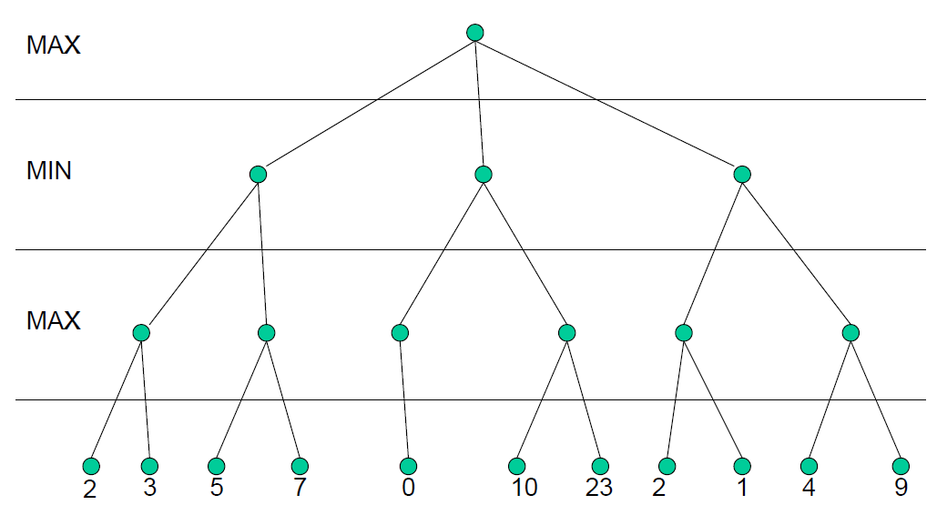
Alpha-beta Pruning

Slide 22
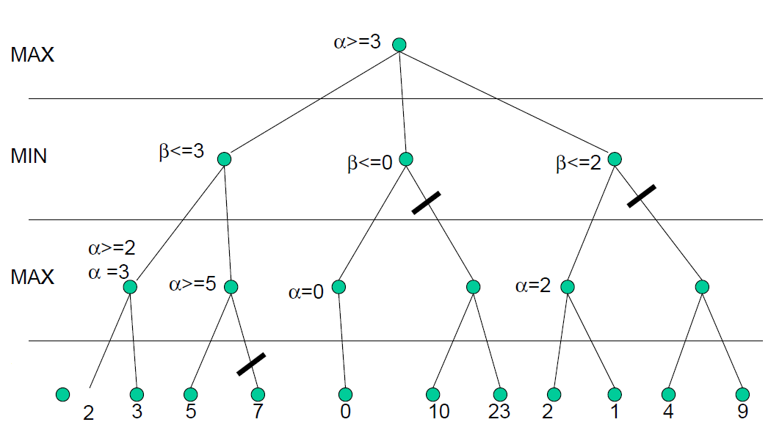
Alpha-beta Pruning

Slide 23
Aplha-Beta
Best and Average case complexity: O power b/d)

Slide 24
Bounded Lookahead
For trees with high depth or very high branching factor, minimax cannot be applied to the entire tree.
In such cases, bounded lookahead is applied:
  search is cut off at specified depth
  static evaluator applied.
Horizon effect
Notes:
Must be applied carefully: In some positions a static evaluator will not take into account significant changes that are about to happen.

Slide 25
Static Evaluation Functions
A static evaluator assigns a score to a position:
  High positive = computer is winning
  Zero = even game
  High negative = opponent is winning
It is most important that a static evaluator will give a better score to a better position – the actual values are not so important.
Notes:
Since game trees are too large to be fully searched, it is important to have a function to statically evaluate a given position in the game.

Slide 26
Creating Evaluation Function
How likely are you to win from a given position?
Usually weighted linear functions
  Different scores are given to different position and added together in a weighted fashion
Possible chess function
  score = 9q + 5r + 3b + 3n + p
    q = # of queens, r = # of rooks, b = # of bishops, n = # of knights, and p = # of pawns

Slide 27
Checkers
In 1959, Arthur Samuel creates a computer program that could play checkers to a high level using minimax and alpha-beta pruning.
Chinook, developed in Canada defeated the world champion:
  Uses alpha-beta pruning.
  Has a database of millions of end games.
  Also has a database of openings.
  Uses heuristics and knowledge about the game.

Slide 28
Chess
In 1997, Deep Blue defeated world champion, Garry Kasparov.
This has not yet been repeated.
Current systems use parallel search, alpha-beta pruning, databases of openings and heuristics.
The deeper in a search tree the computer can search, the better it plays.

Slide 29
Go
Go is a complex game played on a 19x19 board.
Average branching factor in search tree around 360 (compared to 38 for chess).
The best computer programs cannot compete yet with the best human players.
Methods use pattern matching or selective search to explore the most appropriate parts of the search tree.

Slide 30
Games of Chance
The methods described so far do not work well with games of chance such as poker or backgammon.
Expectiminimax is a variant of minimax designed to deal with chance.
Nodes have expected values based on probabilities.

